Slide 1

Eat with Chef
Group Members
Nguyễn Thành Nhân
Lê Quang Khương Duy
Trương Quang Bảo
Phạm Văn Duy
Supervisor
Lâm Hữu Khánh Phương
Group 6

Slide 2
Contents
Business Overview & Solutions
Food Traceability
Main Functions
Technology
Summary
Demo

Slide 3




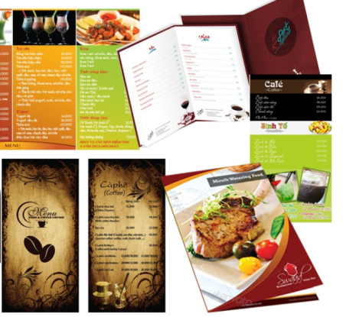

Problem
c
Lack of time to cook
Not confirm food safety
c
c
Bad cooking skill
Want flexible menu
Want delicious dish from chef
Customer

Slide 4



Current trend in Viet Nam

Slide 5
Solution
EWC E-commerce
Food safety & traceability

Slide 6




Solution: EWC E-commerce
Lack of time
Professional food
Who cook your foods?
Daily flexible menu
Food traceability

Slide 7



Solution: EWC E-commerce
Increase
Profit
EWC Company
Increase
Customer relation ship

Slide 8



Solution: EWC E-commerce
Design a good meal for customer
Chef Can…
Share their cooking experience

Slide 9


Solution: EWC E-commerce
satisfaction
Problem
EWC Company
satisfaction
Customer
Eat with chef
System
satisfaction
Chef

Slide 10

What is food Traceability?
Solution: Food Safety & Traceability
Where ingredient come from?
What is ingredient in this dish?
When is the food cooked?

Slide 11

Solution: Food Safety & Traceability
Farm

Slide 12


Solution: Food Safety & Traceability
Distribution

Slide 13
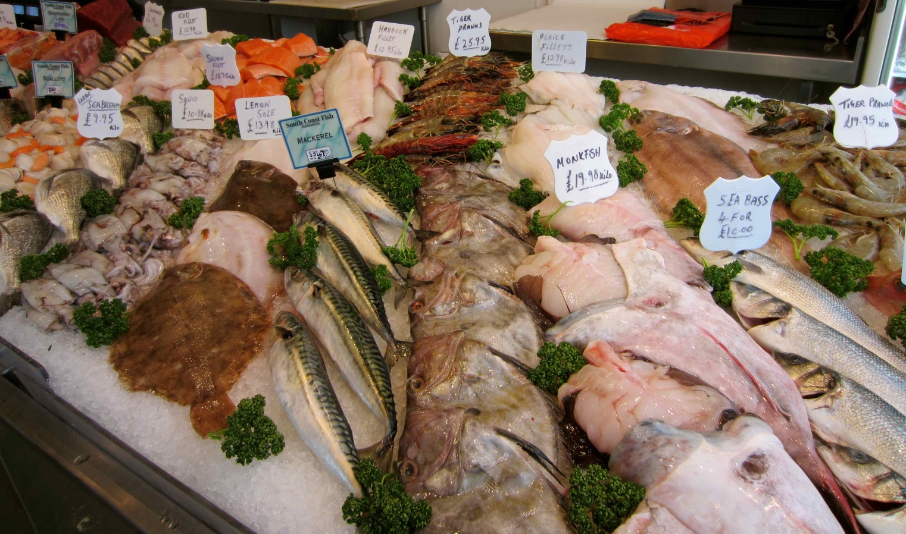
Solution: Food Safety & Traceability
Supply
Retail

Slide 14
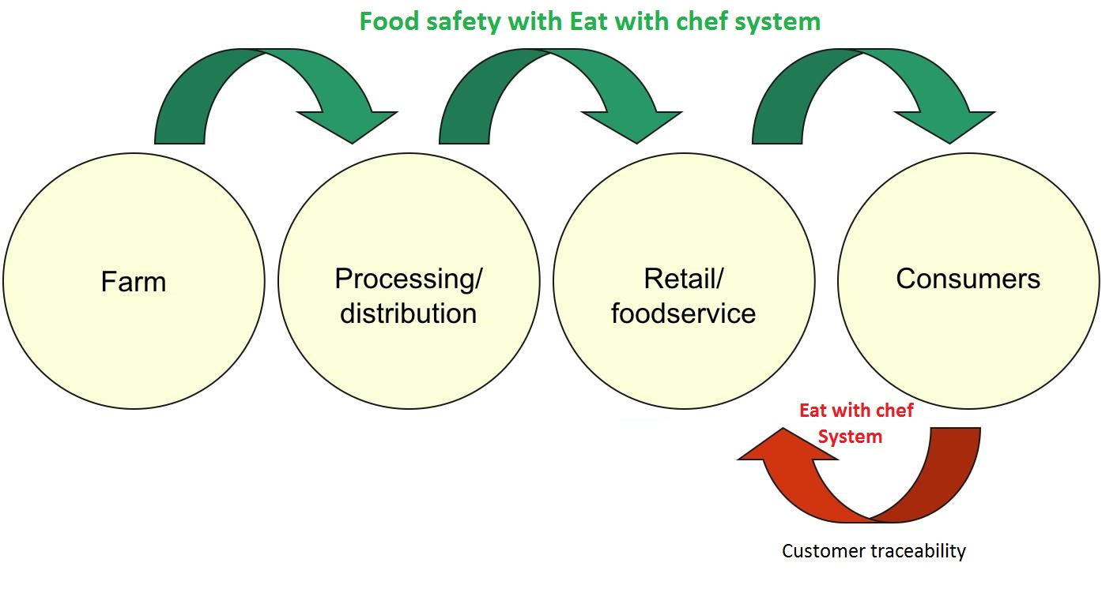
Solution: Food Safety & Traceability
An effective traceability system relies on being able to track product one step forward and one step back at any point in the supply chain.
1
2
3
4

Slide 15

Solution: Food Safety & Traceability

Slide 16
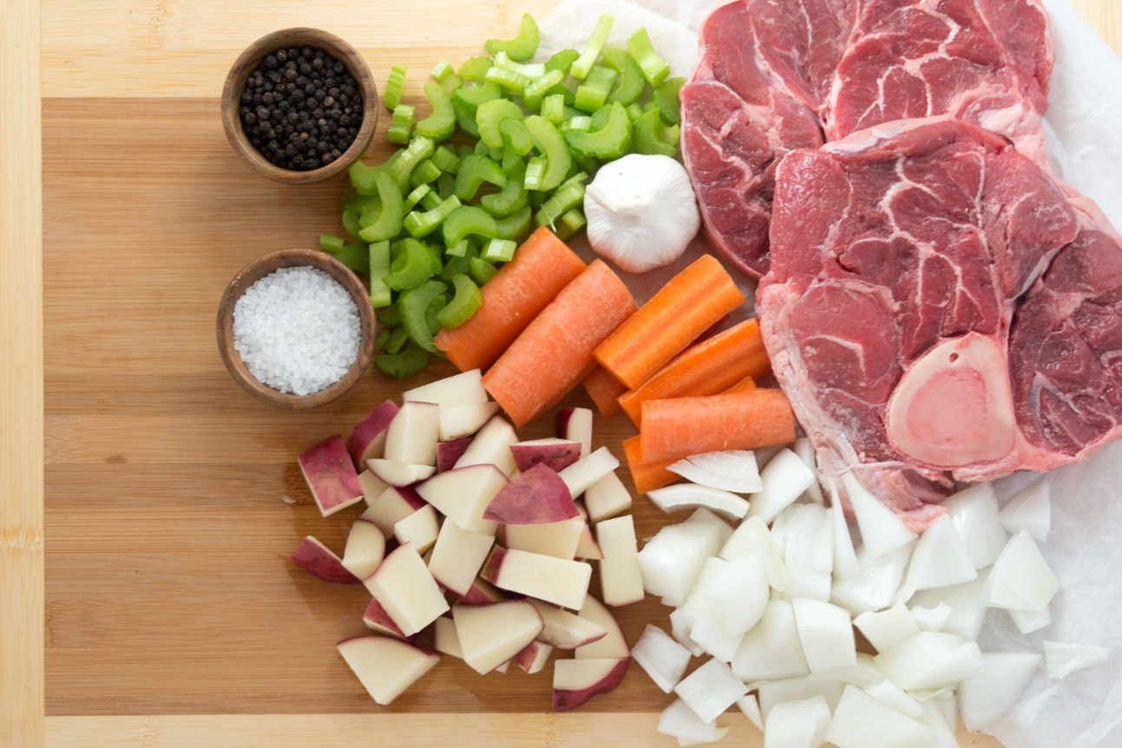
Solution: Food Safety & Traceability
Traceability should be able to identify the source of all food input:
raw materials
additives
other ingredients
packaging
Main Ingredients

Slide 17
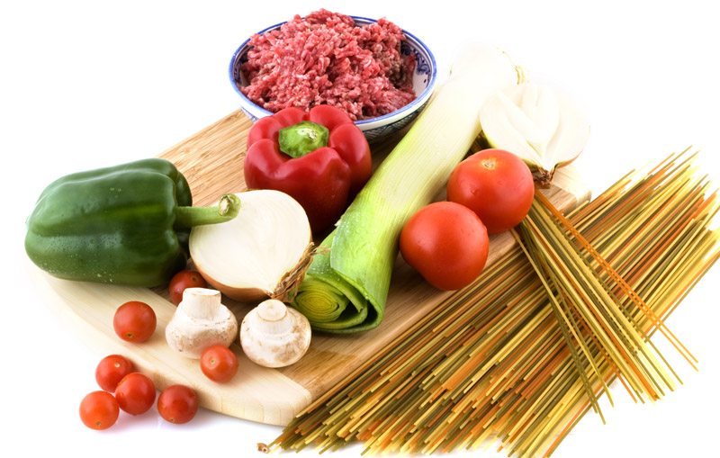
Solution: Food Safety & Traceability
Quantity
Suppliers & Customers Info
Other record
date of transaction or delivery

Slide 18
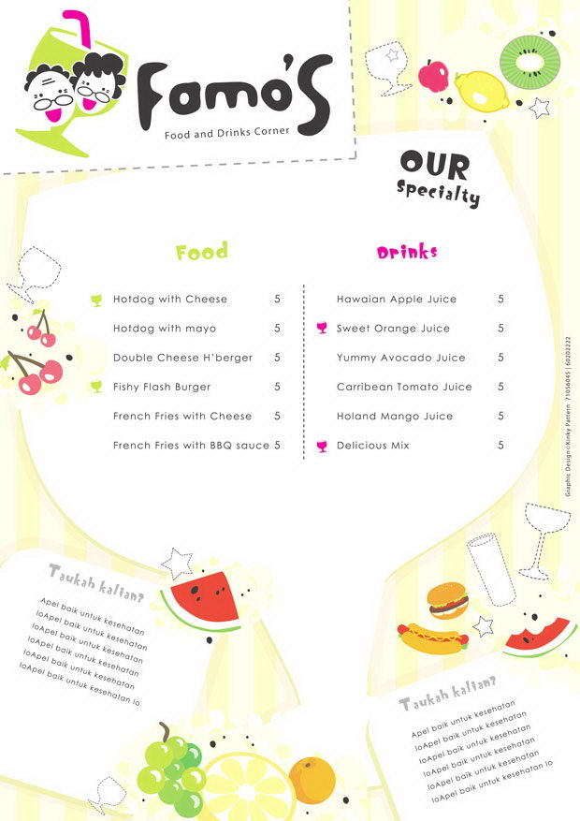

Food Traceability Process - Step 1
Staff
Publish daily menu

Slide 19

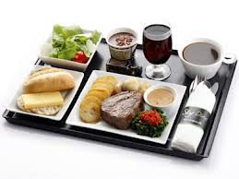
Food Traceability Process - Step 2
Order dishes
Customer

Slide 20

Food Traceability Process - Step 3
Chef
Cook food

Slide 21


Food Traceability Process - Step 4
Scan QR Code
Customer
Food Origin

Slide 22
Main function & Summary

Slide 23
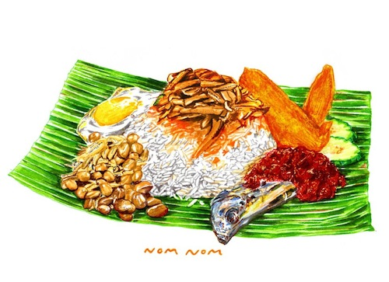



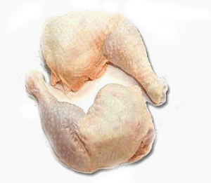
Terms
Dish and Dish Item,
Ingredient and Ingredient item
Cook
Dish
Dish Item
Contain
Contain
Nhà cung cấp
Nông trại Long Thành
Vissan
Ingredient
Ingredient Item

Slide 24




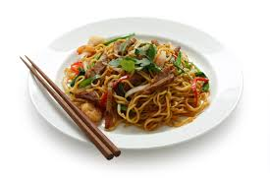
Terms
Dish produce session
Order
Produce sessions
View
Cook
Dishs
Dish need cook today

Slide 25

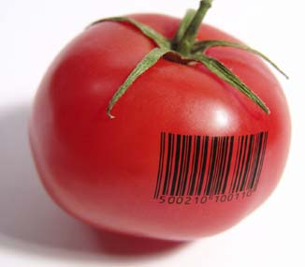
Main functions
Order dishes
Online payment
Customer
View ingredient traceability

Slide 26

Chef
Create dish produce session
Chef
Create dish

Slide 27
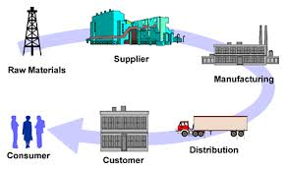
Staff
Publish daily menu
Manage supplier & Ingredient
Staff

Slide 28





Technology
Microsoft Team foundation server

Slide 29
Summary
Achievement
Customer can order dishes easily
Customer can view ingredient traceability by scan QR code and web
Customer can ask cooking question with chef
Staff can publish and manage flexible daily menu
Staff can manage orders easily
Chef can create produce session
Chef can answer cooking question
Limitation
Support only one payment method with Pay Pal
Does not support delivery system

Slide 30
Summary
Future plan
Develop delivery system.
Integrate more online payment methods
Implement gaming and more social for customer
Improve system performance
Improve system as user friendly as possible
Improve business concept

Slide 31
Q&A
Thanks for your listening

